Slide 1
Instrumentation
Mass SpectroMetry
Dr: Leaqaa Abd Al-Redha

Slide 2
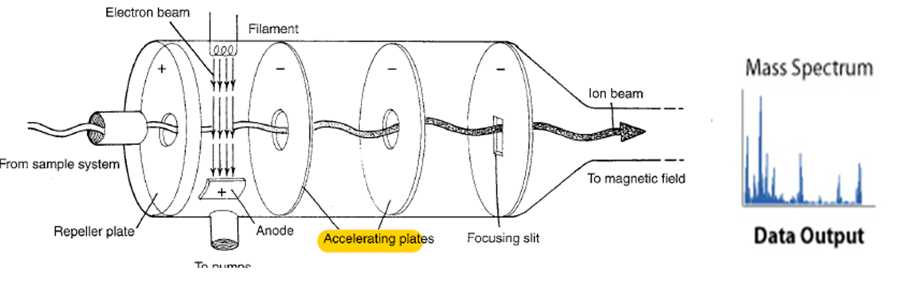
The mass spectrometer performs 3 essential functions:
1st it subjects molecules to bombardment by stream of high energy electrons, converting some of molecules to ions which accelerated in an electric field.
2nd ,the accelerated ions are separated according to their m/z ratio in a magnetic or electric field.
Finally, the ions that have a particular m/z ratio are detected ,amplified and recorder then give mass spectrum

Slide 3
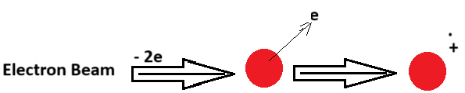
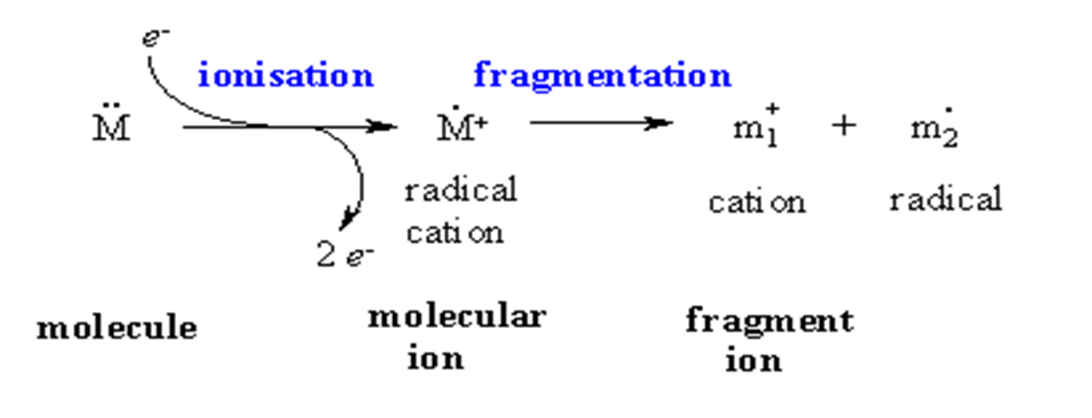
Principle of electron-impact (EI) mass spectrometry :
Atom or molecule hit by high energy beam of electrons lead to formation a positively charged ,free radical called molecular ion.

Slide 4
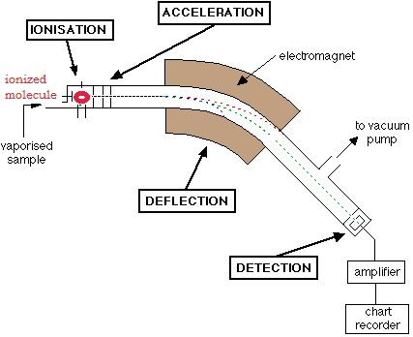
Basic principle: a charged particles moving in a magnetic field
*degree of deflection depends on mass/charge deflected less - heavier molecule more charged = deflected more -

Slide 5
what are the benefit of mass or what are the information can you getted from measurement the Mass?
(MS) is super potent technique
- To give M.Wt
- molecular formula
- Isotopic incorporation
- structural information (fragmentation pattern)
- Protein sequence

Slide 6
Probably the most useful information you should be able to obtain from a MS spectrum is the molecular weight of the sample.
• This will often be the heaviest ion observed from the sample provided this ion is stable enough to be observed

Slide 7
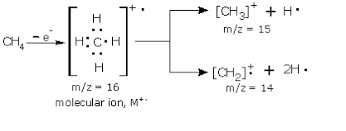
Electron Ionization (EIMS): the basic idea ,wn can used one electront to ionized the molecule
M + eˉ → M⁺ +2eˉ
- if you take CH4

Slide 8
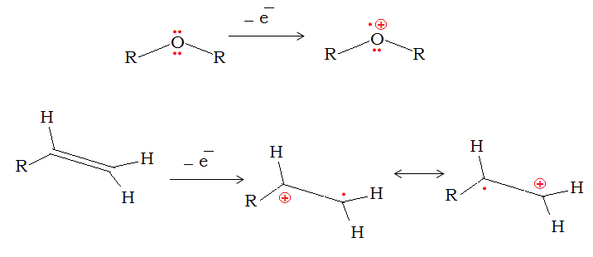

Slide 9
EI : molecular ion radical ------- peak (v. weak)
(m+1)
- Base peak(B.P.) = highest Peak in mass spectrum
- Daughter peaks = results from fragmentation

Slide 10
N Rule :
* if # N in cpd. Odd = molecular mass is odd, inversely if even , molecular mass is 0 or even.
Ph-NO2 C6H5NO2 [ 6C+5H+1N+2O] = 123 odd
CH3OH & CH3NH2
M.F. CH4O CH5N
(12X1) +(4X1)+ (16X1) (12X1)+(1X5)+(14X1)
32 EVEN 31 ODD
N= 0 N=1

Slide 11
Rule of Thirteen : it is giving an indication about the chemical formula for unknown hydrocarbon CnHm :
[ give #s of C & H) step 1 ---------- n = M⁺ /13 step 2 --------- m = n+ r ( r: reminder from step 1)
Q/ The formula for hydrocarbon that have M = 106, can be answer: step 1 = n= M ⁺ /13 = 106/13 = 8.153
= (8)(0.153)
# C = 8 , r= 0.153 x13 = 2 m= n +r ---------------8+ 2 = 10
C8H10

Slide 12
Q/ Cpd. with molecular ion peak m/z= 102,has a strong peak at 1739 cm-1 in IR spectrum(it contain 2 heteroatom 2O).
M⁺ = 102
2O = 2x16 = 32
102- 32 = 70 step 1 : n= M⁺/13 n= 70/13 --------------- n= 5.384
# C = 5 , r = 0.384 x13 = 4.99 =5 m= n + r m= 5+ 5 = 10
C5H10O2

Slide 13
HDI(Hydrogen deficiency Index)
- Giving an indication about may cpd. Contain cyclic (Ring), Ar. Ring or double bond or triple bond and how many of each one.
( For generalized chemical formula)
HDI = IV (C, Si) - 1/2 I (H,X) + 1/2 III (N,P) + 1
HDI = C - H/2 - X/2 + N/2 + 1
[ If HDI = 0 ------------ Aliphatic & saturated
= 1 ------------ 1 Ring (only) or Double bond (only) [Not both them]
= 2 ------------ 2 Double bonds or
----------- 2 Rings or
----------- triple bond or
----------- Ring with Double bond (both)
[benzene Ring contain 3 unsaturated bond & 1 Ring ] = 4

Slide 14
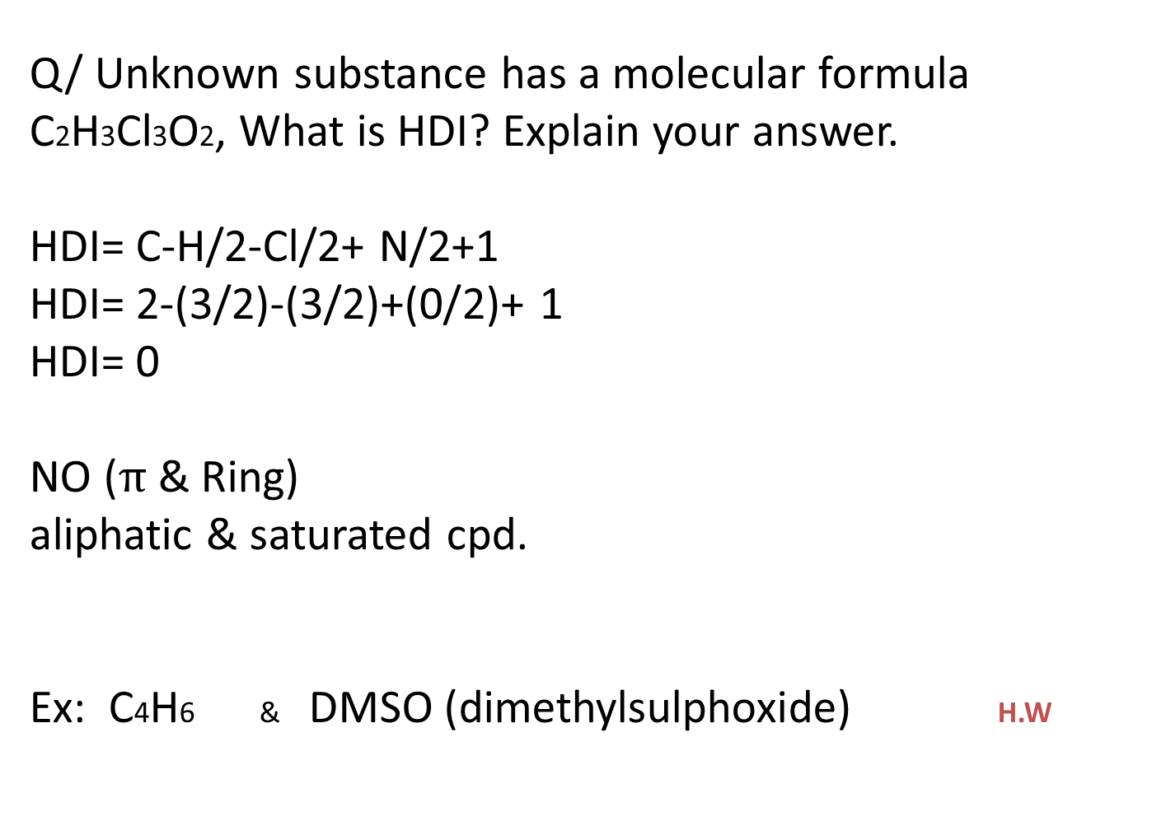
Q/ Unknown substance has a molecular formula C2H3Cl3O2, What is HDI? Explain your answer.
HDI= C-H/2-Cl/2+ N/2+1
HDI= 2-(3/2)-(3/2)+(0/2)+ 1
HDI= 0
NO ($π$& Ring) aliphatic & saturated cpd.
Ex: C4H6 & DMSO (dimethylsulphoxide) H.W

Slide 15
- THE intensity of molecular ion peak depends on the stability of the molecular ion. The most stable molecular ions are those of purely aromatic system, why?
Ar. cpd> conj. Alkene > cyclic cpd.> organic sulfide>short normal alkene > Mercaptane

Slide 16
Mass spectrometry
1- Alkanes
2- Alkenes
3- Aromatic & Alkyl HC
4- Alcohols
5- Phenols
6- Ethers
7- Ketones
8- Aldehydes
9- Carboxylic Acid
10- Lactones

Slide 17
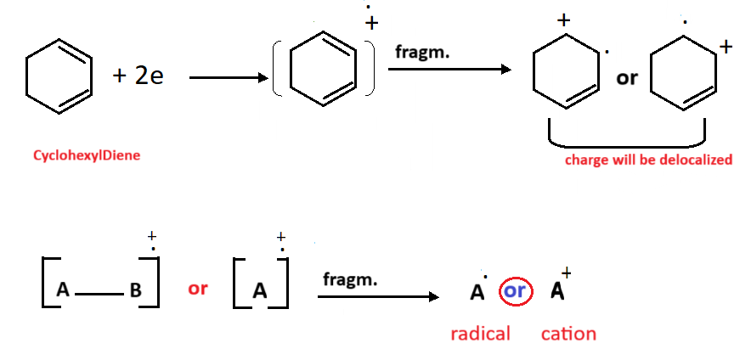
Fragmentation :
* Mass spectrometry read only cation positive charge.

Slide 18
Fragmentation is take place by a process of
Homolysis --------------- called Fish hook
Heterolysis ---------------- called Convential cleavage

Slide 19
Homolytic Cleavage :
Heterolytic Cleavage :

Slide 20
The following general rules have been established to predict prominent peaks in electronic impact mass spectra:
Rule 1:
The relative height of molecular ion peaks (intensity) is greater for straight-chain ions and smaller than that of branched-chain ones.

Slide 21

Rule 2:
Generally, the relative height of the molecular ion peak decreases with increase of the molecular mass (molecular weight) in a homologous series. Fatty ethers may be an exception.
Rule 3:
Due to an ↑ stability of 3◦ carbocations as compared to 2◦ & 1◦ ones, likelihood of cleavage increases as the carbon atom is more substituted.

Slide 22
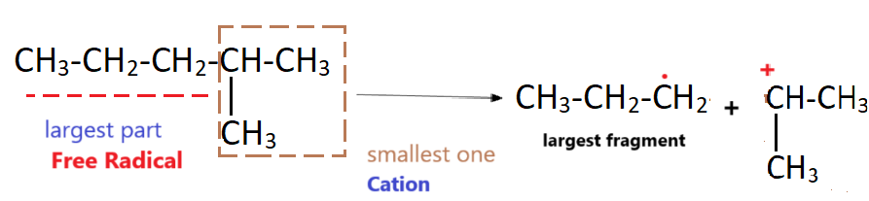
Stevensons Rule :
The longest chain may be eliminated as a radical, because such a radical may be stabilised by stabilisation of the lone pair ion:
Rule 4:
Double bonds , cyclic structures, heteroatom (O,S,N) Rings can stabilized molecular ion (M+) peak and increase the probability for its appearance.
Ar. Ring also , ↑ stability of cpd. by Resonance

Slide 23
Rule 5:
Double bonds favour allylic cleavage, resulting in formation of resonance-stabilised allylic cations:

Slide 24

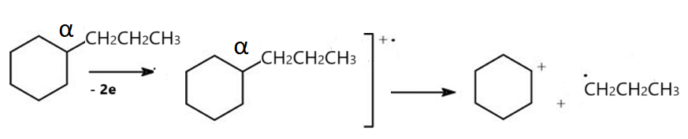
Rule 6:
Cyclic alkanes with side chains cleave at α , and the positive charge tends to remain on the cyclic fragment:

Slide 25
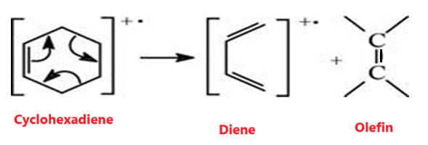
Retro-Diels Alder reaction:
Unsaturated rings may undergo a Retro-Diels-Alder reaction:

Slide 26
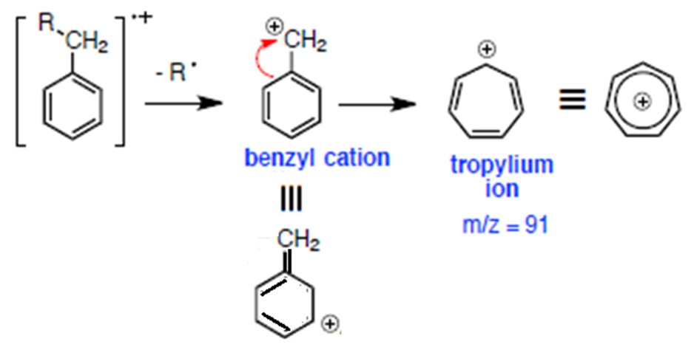
Rule 7:
Alkyl arenes(Alkyl substituted Aromatic cpd.), cleavage at the β to the aromatic ring and give rise to a Resonance-stabilized benzyl ion or a Tropylium ion.

Slide 27
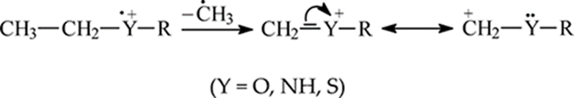
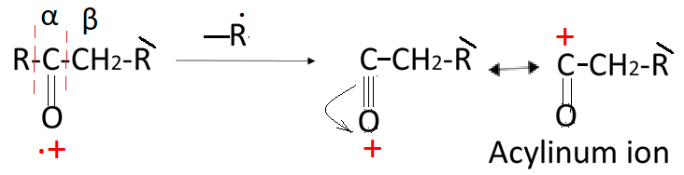
Rule 8:
The C–C bond next to the heteroatom (O,NH,S) are cleaved ,leaving charge on the fragment heteroatom-containing fragment:
(α & β)

Slide 28
What r- the factors that effect on the fragmentation process?
1- Bombardment energy
2- Function group
3- Thermal decomposition

Slide 29
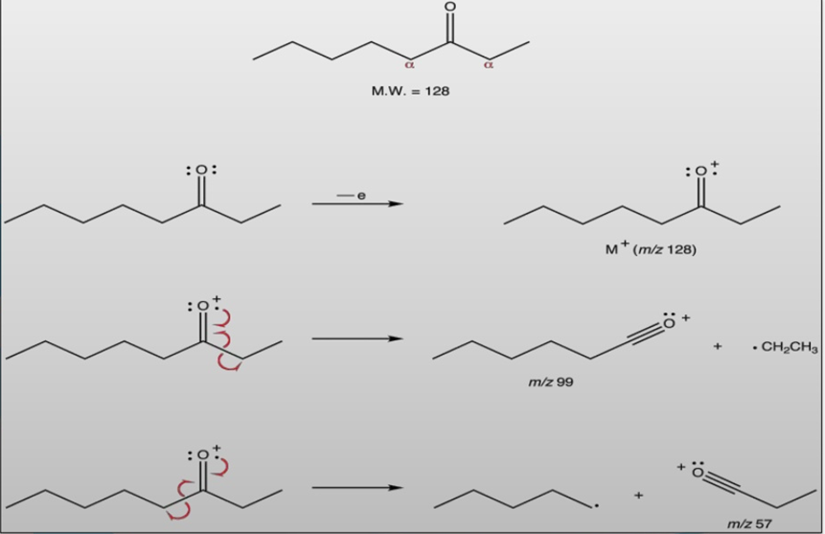

Slide 30
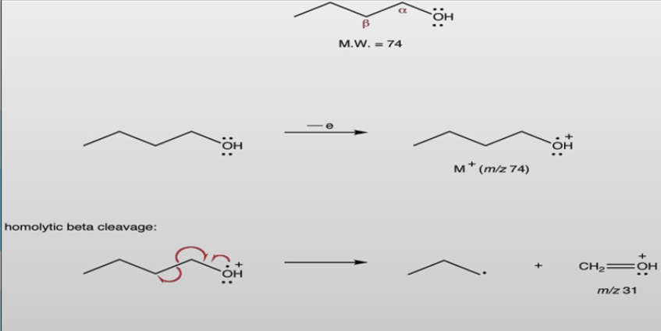

Slide 31
So, the fragmentation of the molecular ion peak take in the following Modes:
1- Simple cleavage a- Homolytic cleavage b- Heterolytic cleavage c- Retro Diels-Alder reaction
Rearrangement reaction accompanied by transfer of atoms: a- Scrambling b- Meclafferty Rearrangement c- Elimination

Slide 32
* Rearrangement reactions accompanied by transfer of atoms:
1- Scrambling fragmentation giving rise to stable carbocation: ex- M⁺ from Alkyl benzene undergoes at benzylic bond and final product is 7 membered cyclic ion known as
Tropylium ion

Slide 33
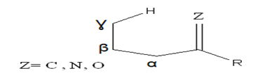
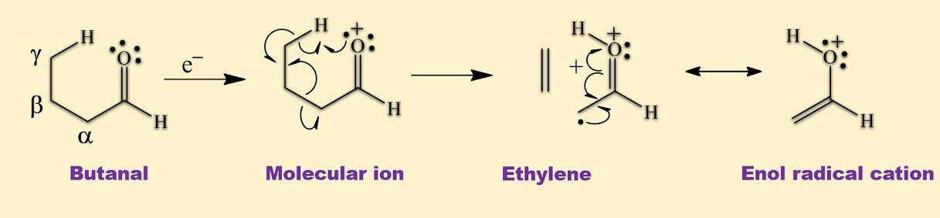
McLafferty rearrangement:
Requirments for doning Mclafferty rearrangement:
1- Contain heteroatom(Z)
2- π system
3- (γ-H)
(intramolecular atomic rearrangment)

Slide 34
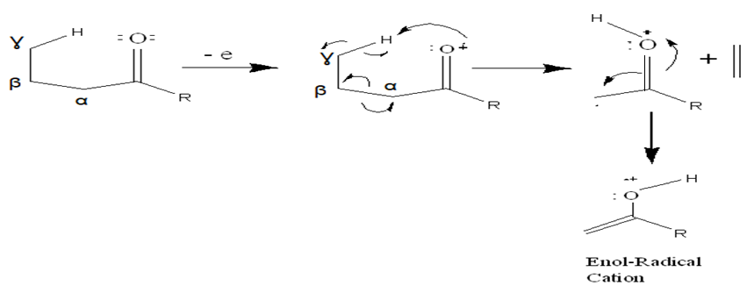

Slide 35
3-Elimination:
Fragmentation due to loss of small molecule :
Loss of small stable molecules such as H2O,CO2 ,CO, C2H4 from molecular ion during fragmentation.
EX. An alcohol readily looses H2O molecule and shows a peak 18 mass units less than the peak of molecular ion.

Slide 36
Alkanes:
-saturated H.C.
- favorite breakdown position in alkane not in C1 &C2. While the prefer is C2 &C3
- Straight chain of alkanes show low intensity M.ion peak.
The intensity decrease with increase length chain

Slide 37
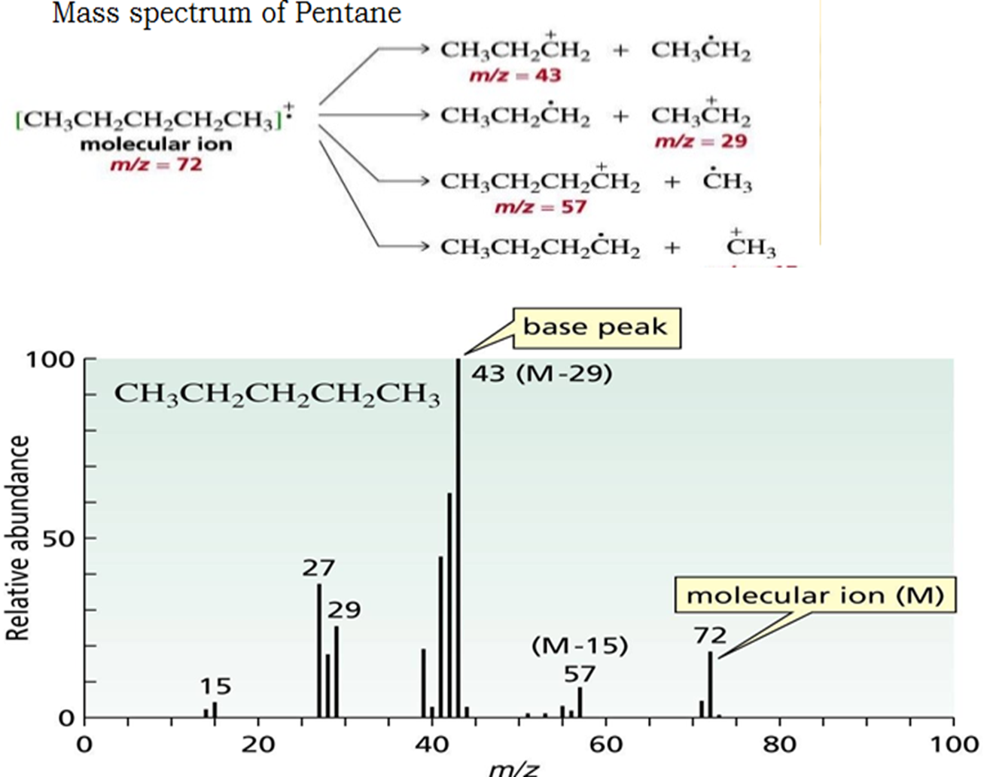

Slide 38
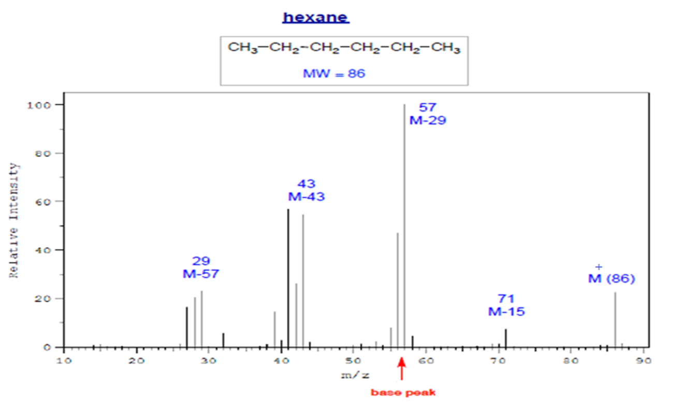
Straight Chain Alkanes

Slide 39
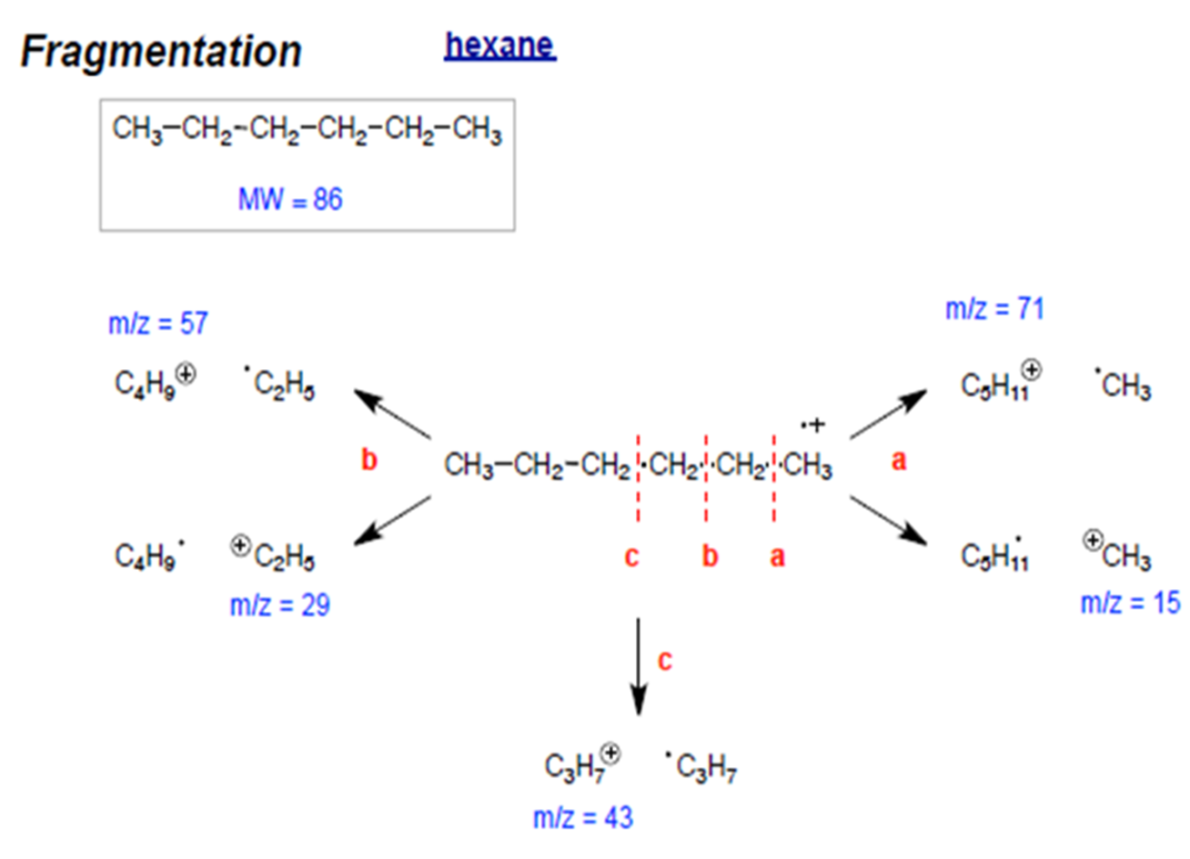

Slide 40
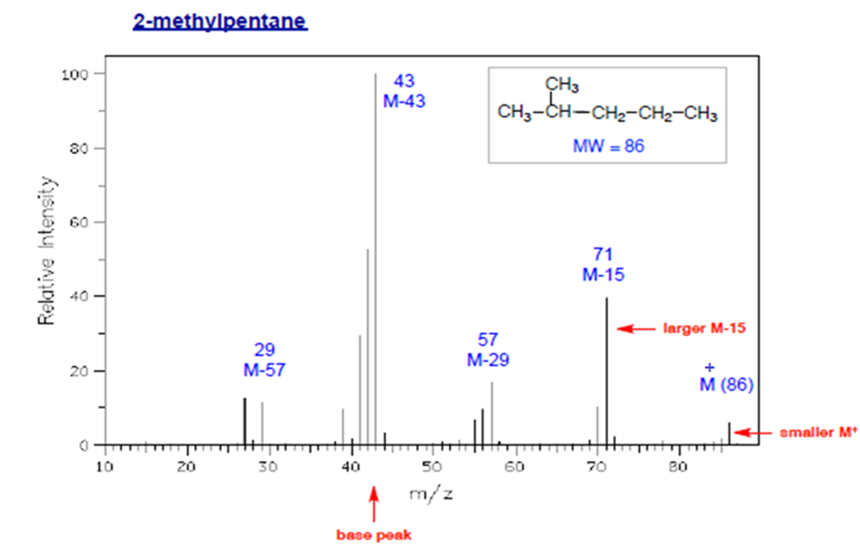
Branched Alkanes
• Smaller M⁺ peak; may be absent
• More fragmentation at highly branched positions
* preference for 2 ͦ, 3 ͦ carbocation

Slide 41
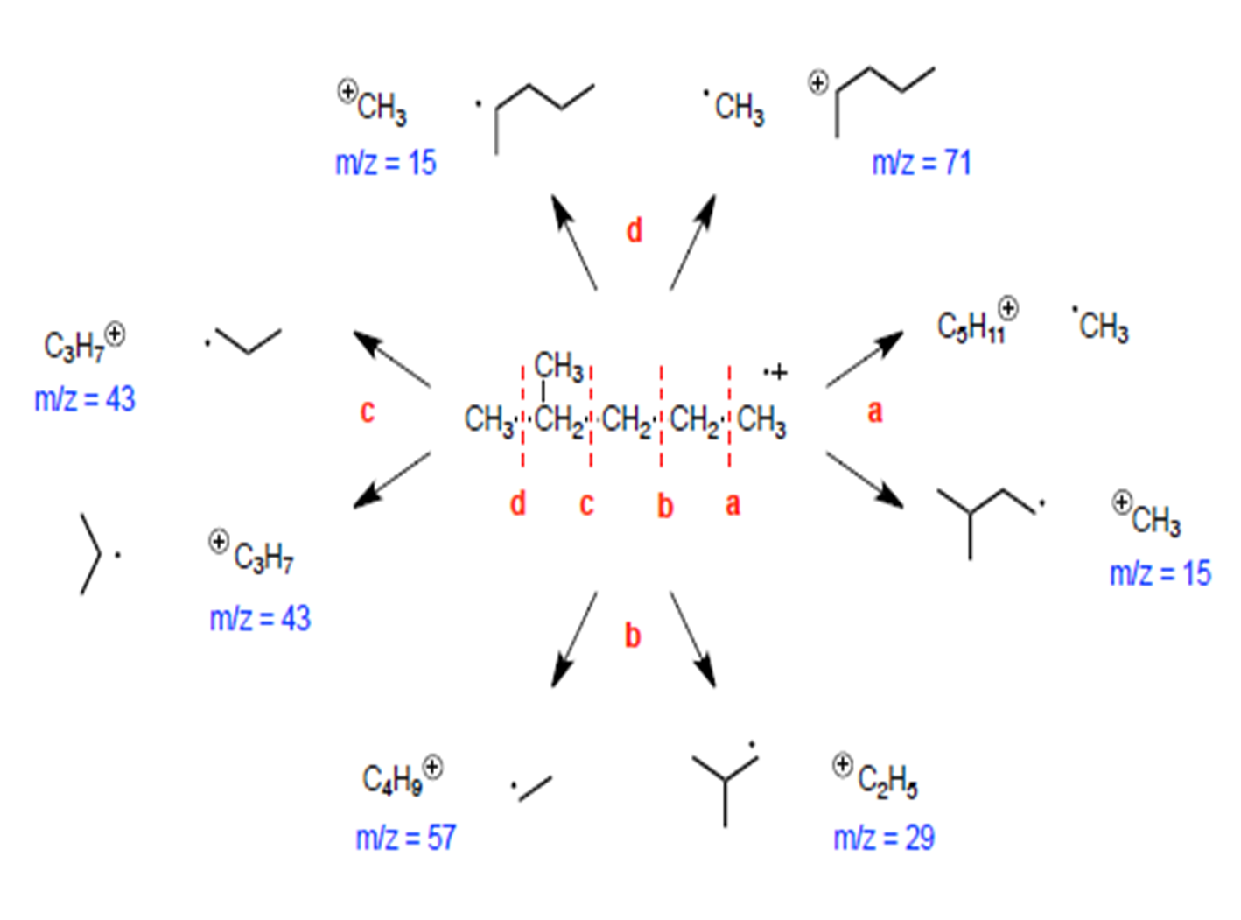

Slide 42
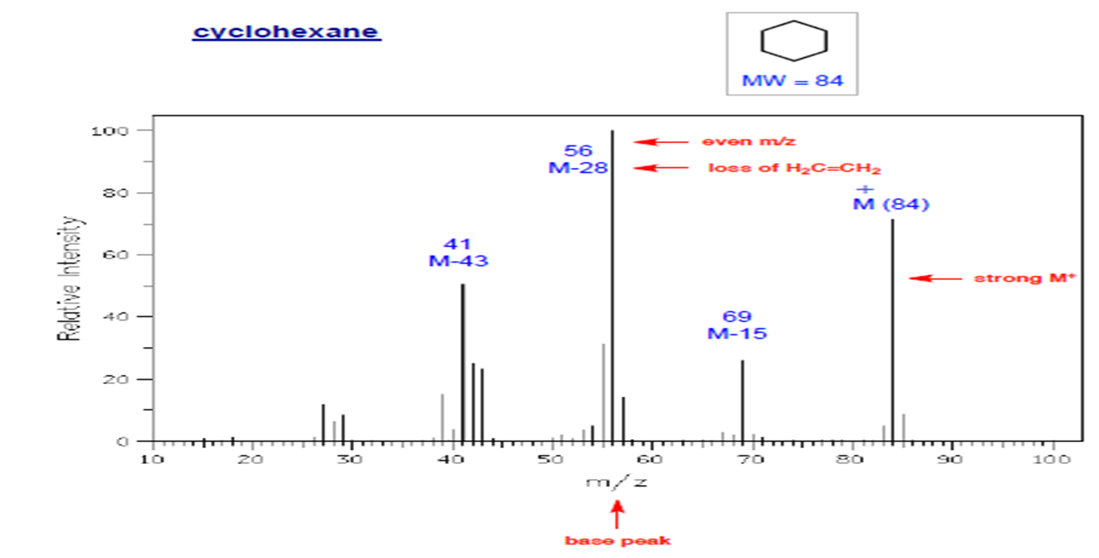
Cycloalkanes
• Relatively large M⁺ peak
• Significant peak at M-28 (often the base peak) due to loss of ethylene
• M-15: from rearrangement.

Slide 43
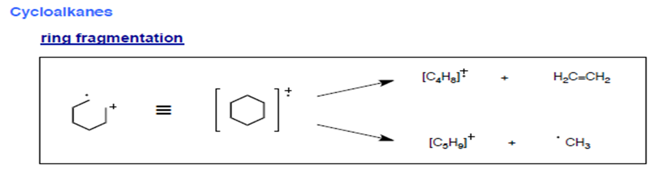
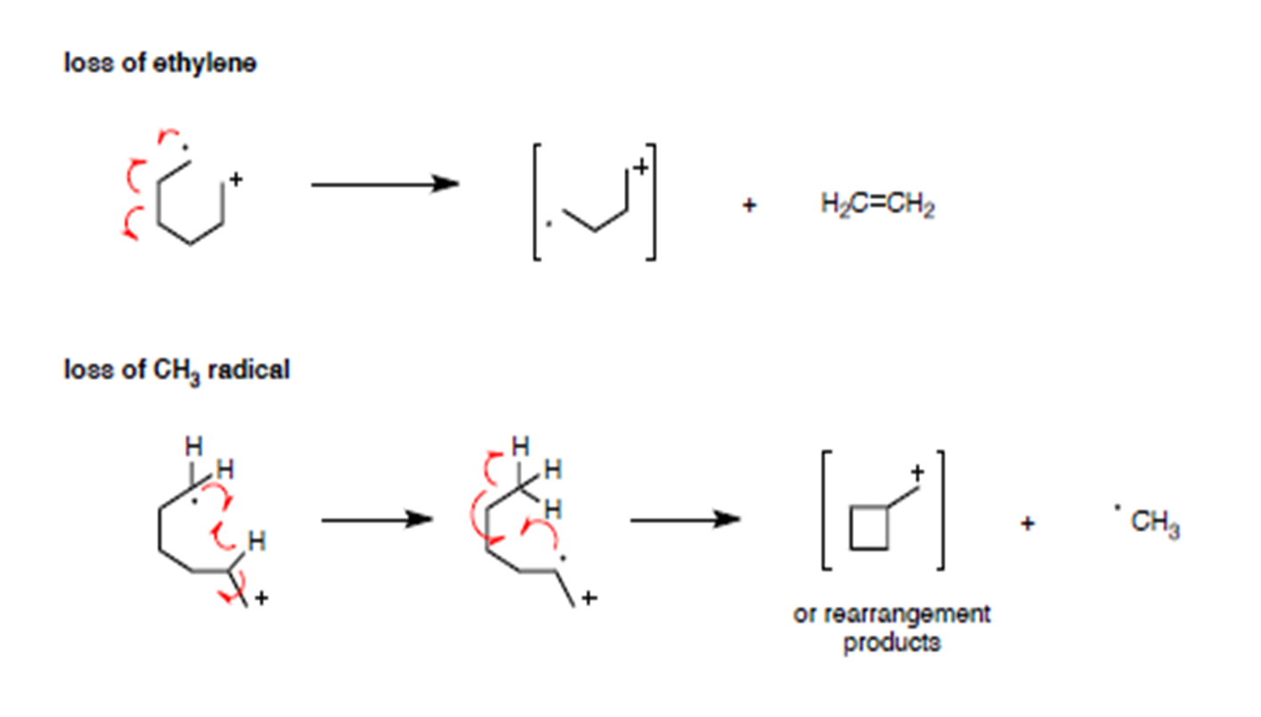

Slide 44
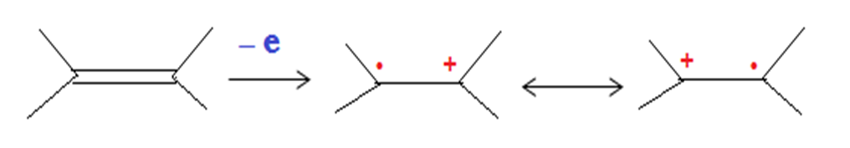
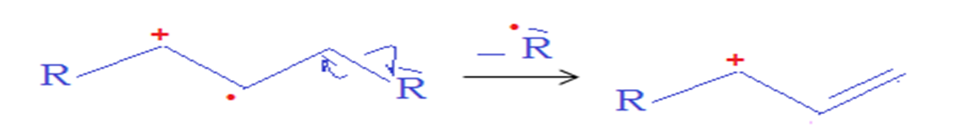
Alkenes
Acyclic Alkenes
• Relatively strong M⁺ ion
• A series of peaks: M-15, M-29,M-43,M-57, etc
• Strong peak from fragmentation to form a resonance stabilized allylic cation(m/z = 41 in terminal double bond.
* homolytic cleavage to give allylic carbocation

Slide 45
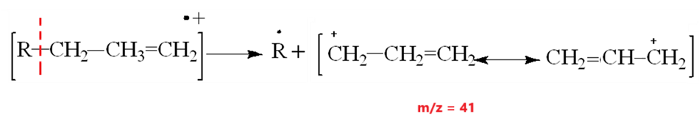
Allylic carbocation: m/e=41

Slide 46
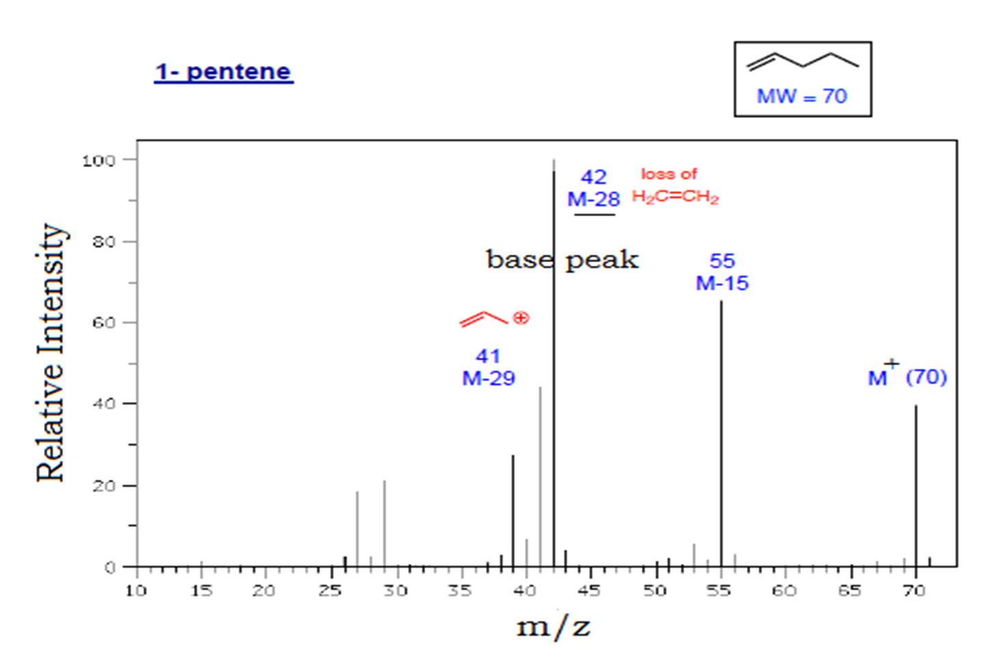

Slide 47
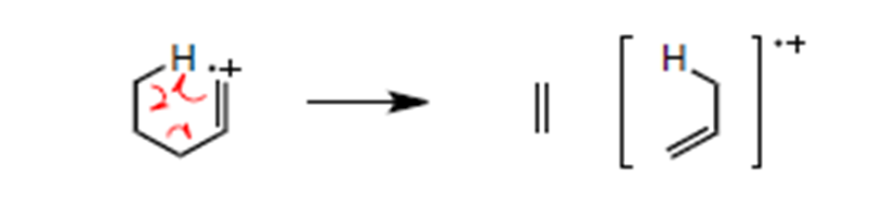
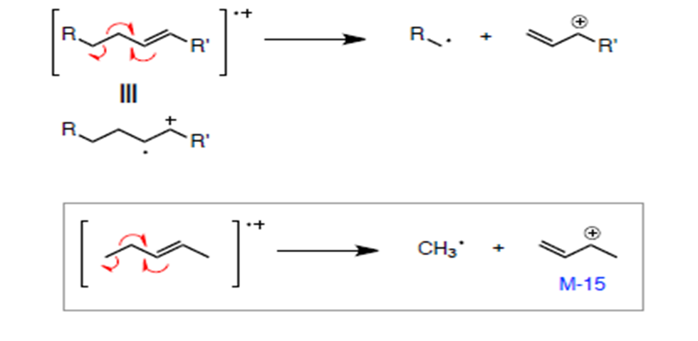
fragmentation processes
• McLafferty rearrangement
• allylic α-cleavage

Slide 48
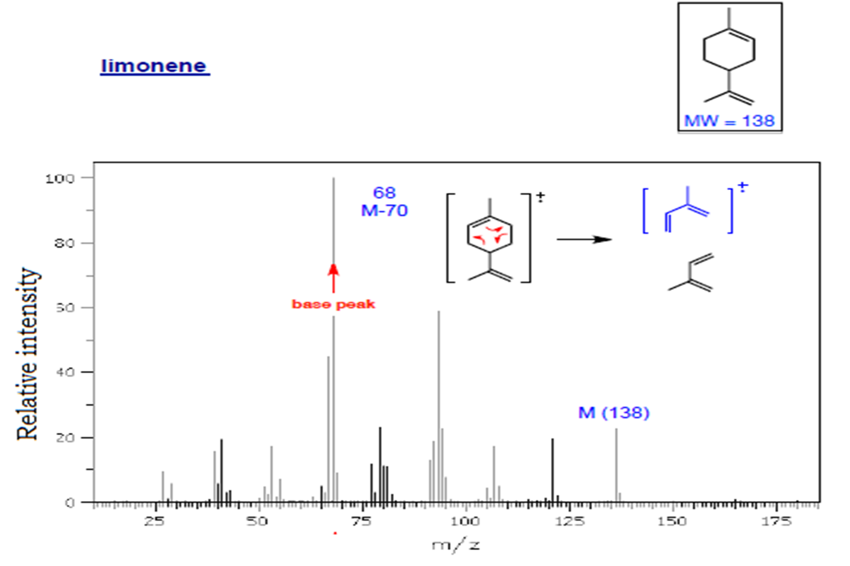

Slide 49
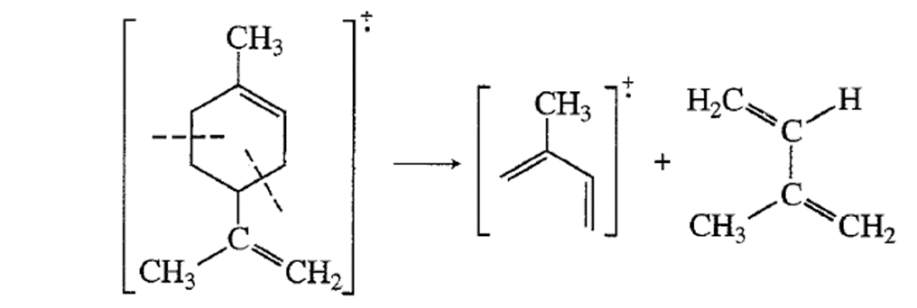

Slide 50
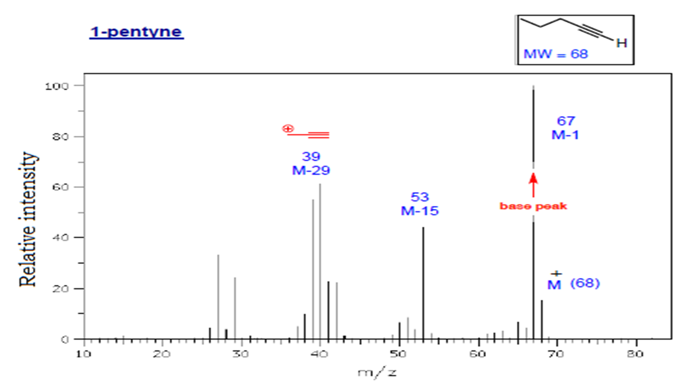
Alkynes
• Strong M-1 peak is observed in terminal alkynes
• Strong peak from fragmentation to give resonance stabilized propargyl cation(m/z = 39 [important]in terminal alkynes)

Slide 51
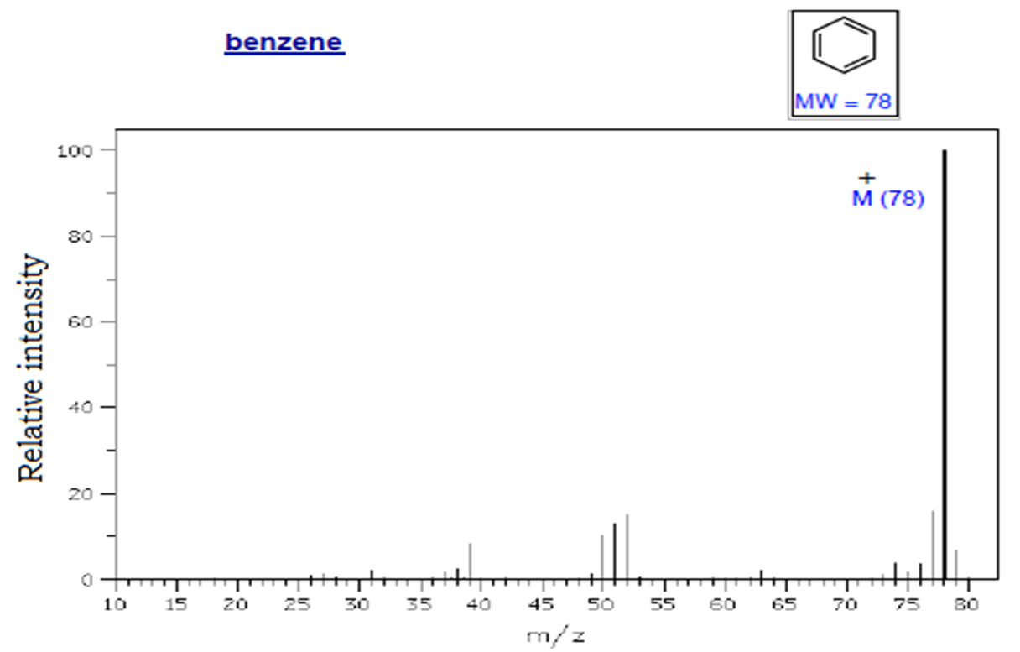
Aromatic Hydrocarbons
• Strong M⁺ ion

Slide 52
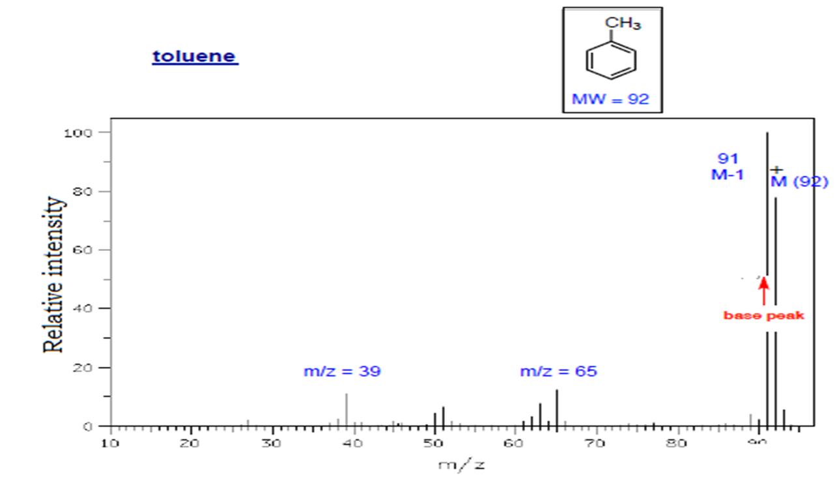
* Methyl benzene (toluene)
-Important Properties is give benzyl cation= tropylium ion
• Substituted benzenes can undergo McLafferty rearrangement .r.
(substitutent = propyl or larger)

Slide 53
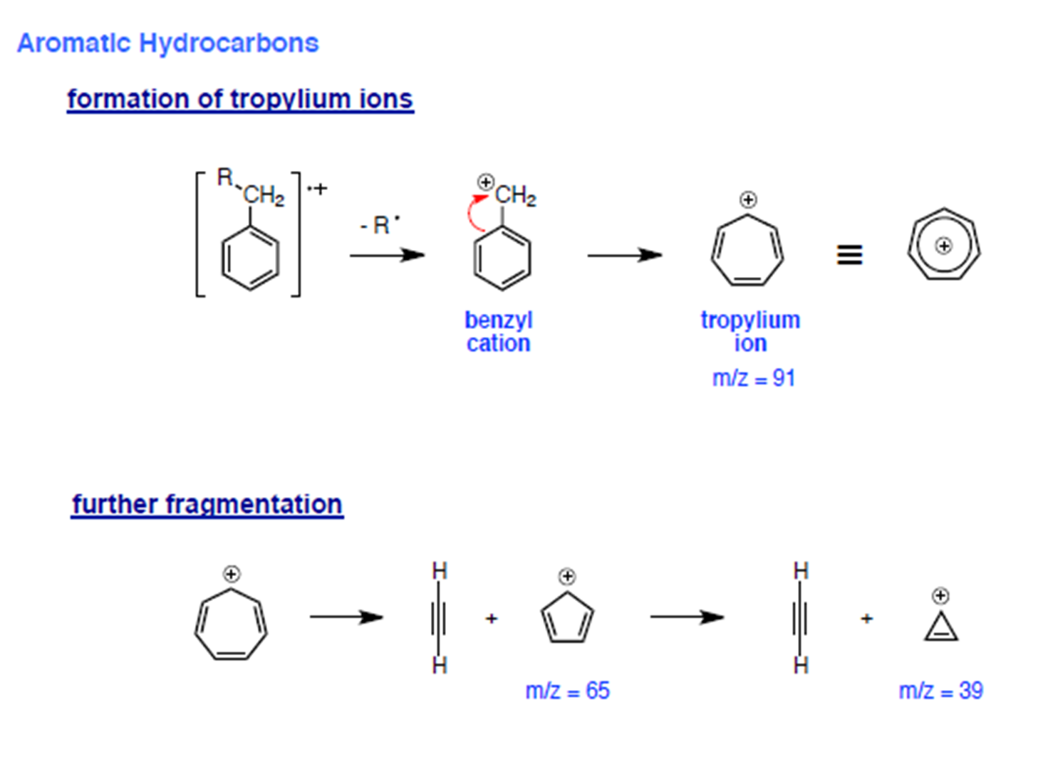

Slide 54
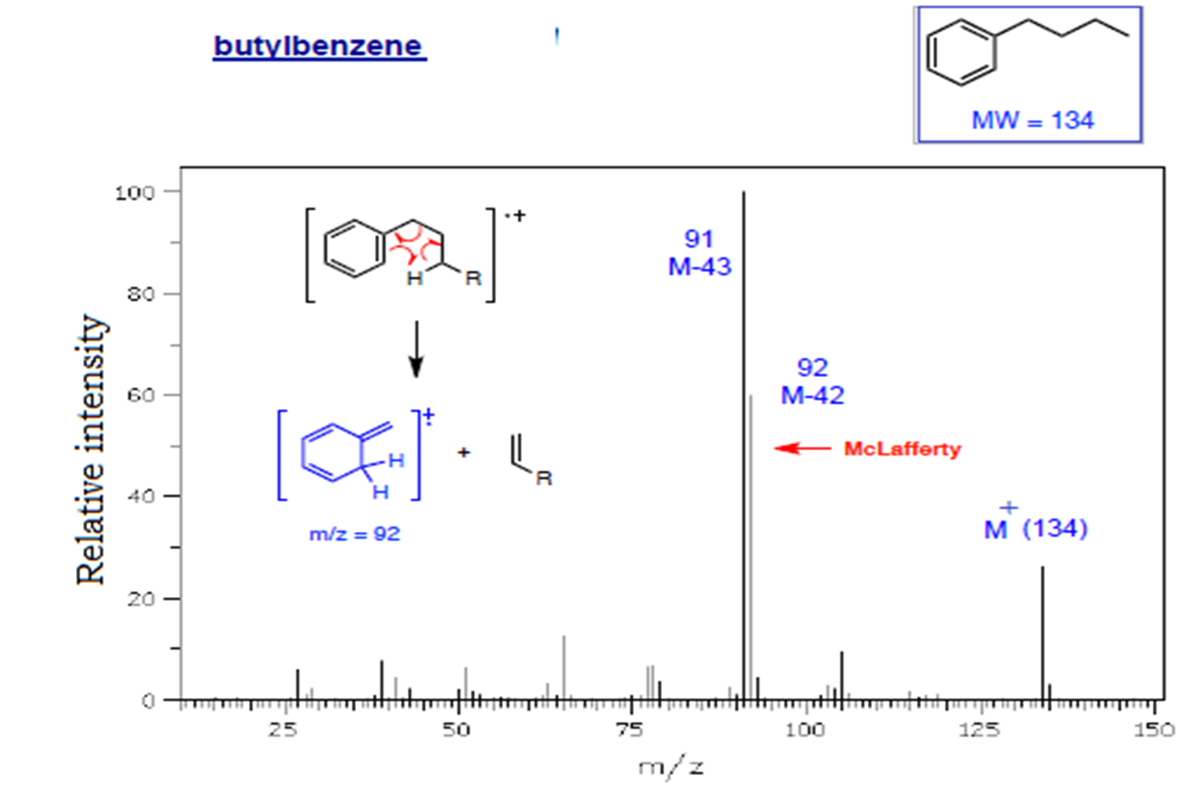

Slide 55
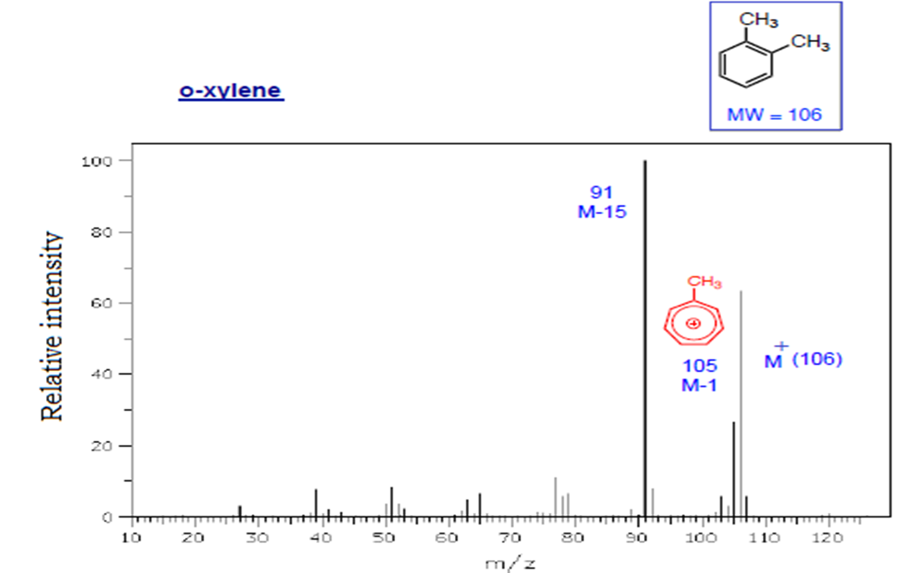

Slide 56
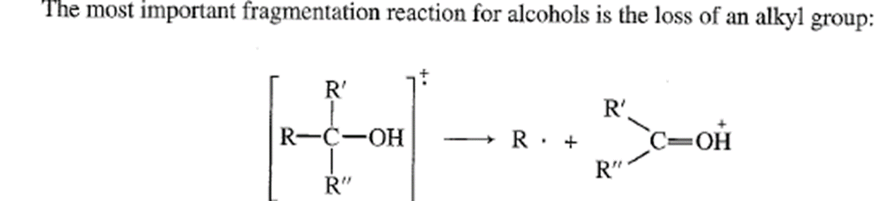
Alcohols
Acyclic Alcohols
• Dehydration (M-18), sometimes with loss of CH2=CH2
• α-Cleavage of an alkyl radical (1° alcohols show m/z = 31)
Largest substituent lost first

Slide 57
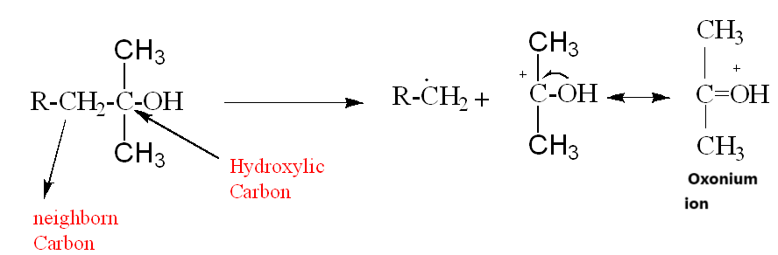
-major rout for fragmentation of alcohol is cleavage bond (.) CH2-OH & neighborn C.

Slide 58
- also, Alcohols loss H2O molecule (m/z=18, M-18) = 1 & 2 alcohol
* Elimination of H2O & Alkene from 1 alcohol, accounts for the Prescence of a peak at M-(alkene + H2O) that is peak at M-46, M-74, M-102.

Slide 59
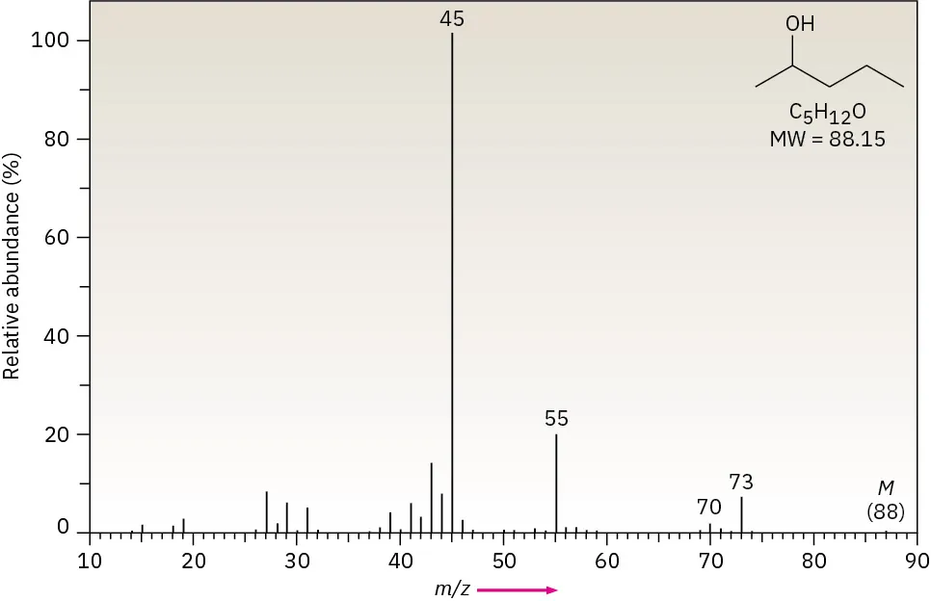
Alcohols: fragmentation by two pathways: α- cleavage and dehydration.
In the α-cleavage pathway, a C–C bond nearest the hydroxyl group is broken, yielding a neutral radical plus a resonance-stabilized, oxygen-containing cation.
EX: 2-pentanol

Slide 60
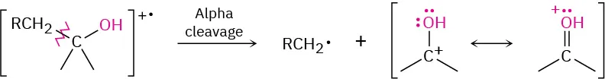
1-
2-

Slide 61
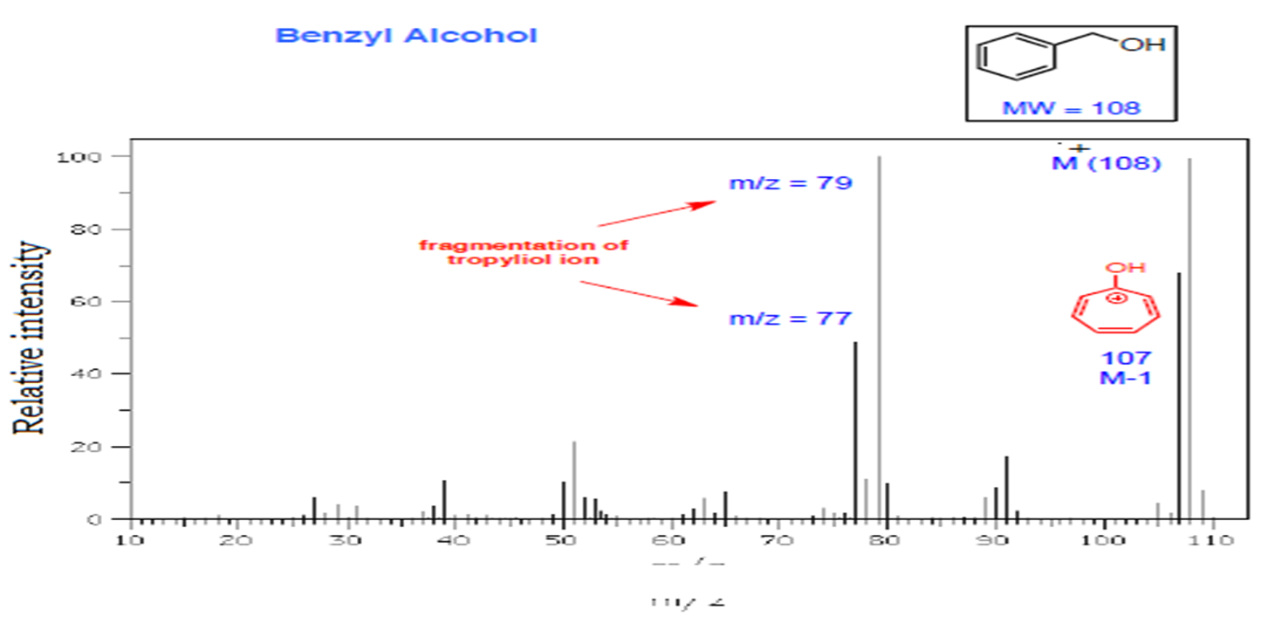
Benzyl Alcohols
• 1◦ - Alcohol
• formation of tropyliol ions; then fragmentation to C6H5

Slide 62
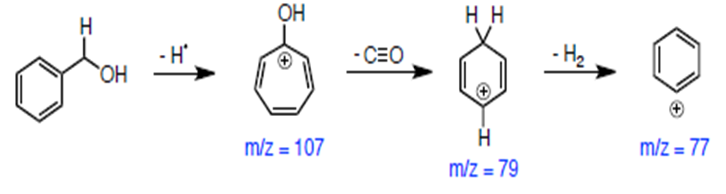
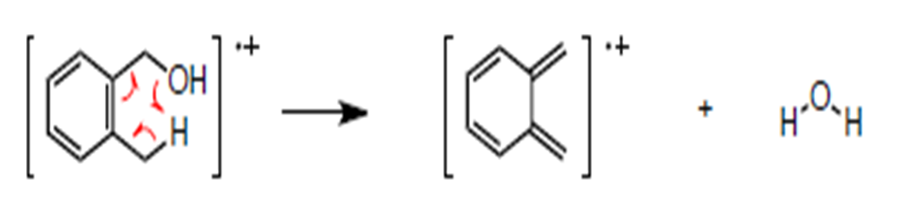
fragmentation of tropyliol dehydration (wn o-substituted on benzyl alcohol): more stable
Mm/z=104

